Slide 1
ME 203 Introduction to MATLAB
1

Slide 2
Repetition Structures
Often called loops
Used for code that will be repeated
Each repetition is called a pass
Loops allow you to repeat sequences of code until some criterion is met
5 basic parts
A parameter (loop variable) which determines whether or not to end the loop
Initialization of this parameter
A way to change this parameter each time we go through the loop
A comparison (using the parameter) to a criterion used to decide when to end the loop
Calculations to do inside the loop (command block)

Slide 3
For Loops
For loops are used when you know in advance how many passes through the loop you need to make
Matlab syntax
The loop variable
Is defined as a vector
Is a scalar within the command block
Does not have to have consecutive values (but it's usually cleaner if they're consecutive)
The command block
Anything between the for line and the end
for loop_variable = start_val:increment:end_val commands
end
Command block

Slide 4
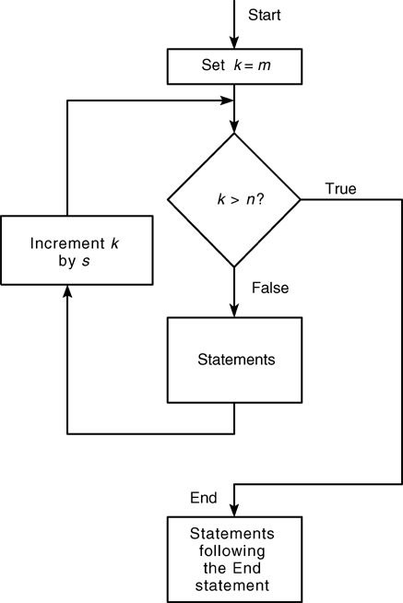
For Loop Flow Chart
k= m:s:n
m is the initial value of a loop
s is the increment value
n is the terminating value
Will loop until k exceeds n
False
True
Figure 4.5-1

Slide 5
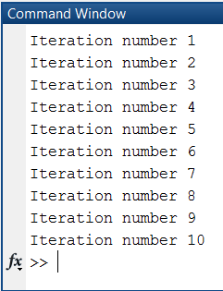
For Loops
for loop_var = 1:10
fprintf('Iteration number %d\n', loop_var)
end

Slide 6
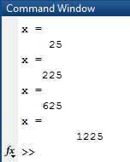
Example
for k=5:10:35
x=k^2
end
1. The loop variable k is assigned an initial value of 5
2. x is calculated (x=k^2)
3. Each pass through the loop increments k by 10 and calculated x until k exceeds 35
Loop variable is a vector?
Command block with loop variable, k
Note the expression k=5:10:35 or generically k= m:s:n
m is the initial value of a loop, which is incremented by the increment value, s. The loop continues until the loop variable exceeds the terminating value, n.

Slide 7
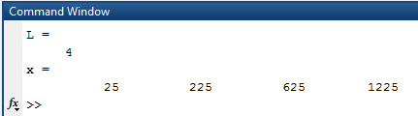
Example
Rewrite previous example using indexing and script formatting
% Indexing example
clc; clear all; format compact
%Given
k=5:10:35;
%Calculate length of vector k
L = length(k)
%Calculate x
for i=1:L
x(i) = k(i)^2;
end
%Display answer
x
Spacing of 1
Note: no need of .^ operator

Slide 8
Example
for k = 5:2:14
fprintf('new k = %d\n',k)
x = k^2;
fprintf('new x = %d\n',x)
end

Slide 9
For loops
Example: Iterate the loop over odd integers from 273 to 1 (inclusive).
for k = ???
% commands
% commands
end
Answer: k = 273:-2:1

Slide 10
Nested Structures
Nested for loop and if statement structure example
for i=start:increment:end
commands
if conditional statement
commands
end
commands
end

Slide 11
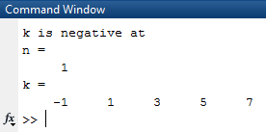
Nested Structures- for and if
Calculate k=2*n-3 for n=1:5. Show an error message if k is negative and the
index of the negative value
% Nested for and if example
clc; clear all; format compact
% Calculate k
for n=1:5
k(n)= 2*n-3;
if (k(n)<0)
disp ('k is negative at')
% Display index of negative value
n
end
end
% Display result
k

Slide 12
For loops - Example
Given: Fibonacci Numbers are created by adding the previous 2 numbers in the sequence
The first two Fibonacci numbers are 0 and 1 therefore the next Fibonacci numbers would be 0+1=1
1+1=2
1+2=3
2+3=5
Etc.
Find: Write a code that uses for loops to calculate the first 10 Fibonacci numbers

Slide 13

Example
% Fibonacci numbers example
clc; clear all; format compact
%Given
F(1) = 0;
F(2) = 1;
% Calculate Fibonacci numbers
for i=3:10
F(i) = F(i-1) + F(i-2);
end
%Display results
F

Slide 14
While Loops
While loops are used when the looping process must terminate when a specific condition is satisfied
The number of passes is NOT known in advance
Matlab syntax
The command block will execute while the condition is true
Beware of infinite loops!
statement to assign value to loop variable
while condition
commands
statement to change value of loop variable
end

Slide 15
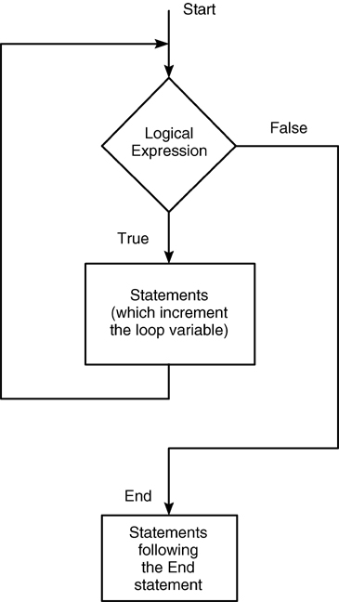
While Loop Flow Chart
Figure 4.6-1

Slide 16
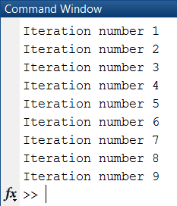
While Example 1
initialize a loop variable/counter
loop_var = 1;
while loop_var < 10
fprintf('Iteration number %d\n', loop_var)
loop_var = loop_var + 1;
end
Loop repeats as long as loop_var<3
loop_var increments by 1

Slide 17
While Example 2
Write the equivalent while loop
for j = 1:2:10
a = j*j;
disp(a)
end
Loop variable: j
Start value: 1
Increment: 2
Loop ends when j = 10
Loop variable, start value
j = 1;
while j < 10
a = j*j;
disp(a)
j = j + 2;
end
Condition
Increment loop variable

Slide 18
While loops
Example: How many times will the loop be executed?
n = -2;
while n < 10
n = n*2;
end
Answer: Infinite loop
Because with each iteration, n becomes increasingly negative

Slide 19

While Example 2
n=0;
while (n<10)
n=n+1
k(n)= 2*n-3;
end
k
n is initialized as a counter
Loop repeats as long as n<10
n increments by 1
commands
Saves k for each value of n
Final result is a vector not a scalar

Slide 20
While Example
k = 5;
while k<14
fprintf('new k = %d\n',k)
x = k^2;
k = k+2;
fprintf('new x = %d\n',x)
end

Slide 21
Break and Continue
The break command can be used to terminate a loop prematurely (while the comparison to the first line is still true)
The continue command skips the remaining commands for the current pass
If the while or for statement is still true Matlab will move on to the next pass

Slide 22
Break Example
1 <= n <= 10, y = cos(n*π/10) , z = log(y)
clc; clear all; format compact
n = 0;
while n <= 10
n = n + 1;
y(n) = cos(n*pi/10);
if y(n) <= 0
break
end
z(n) = log(y(n));
end
y
z
break: If any element of y becomes negative or zero, the break command causes MATLAB to exit the loop even if the loop condition (n<=10) is still true

Slide 23
Break Example
You deposit $1000 in a bank account which pays 6 percent annual interest. Use a for loop in MATLAB to determine how long it will take to double your deposit.
clc; clear; format compact
balance = 1000;
for years = 1:1000
balance = balance*1.06;
if balance >= 2000
break
end
end
years
balance
break: If balance >=2000, the break command causes MATLAB to exit the for loop

Slide 24
Continue Example
1 <= n <= 10, y = cos(n*π/10) , z = log(y)
clc; clear all; format compact
n = 0;
while n <= 10
n = n + 1;
y(n) = cos(n*pi/10);
if y(n) <= 0
continue
end
z(n) = log(y(n));
end
y
z
continue: terminates the current pass and skips to the next. It still counts the “bad” pass.

Slide 25
Switch and Case
Used when a series of programming path options exist for a given variable depending on its value
Similar to the if/else/elseif
Allows you to choose between multiple outcomes based on a criterion
Criterion can be a scalar or string
The advantage of the switch structure is that in some situations, it yields code that is more readable

Slide 26
Switch Case
Switch variable
Case option1
code to be executed if variable is = to option 1
Case option2
code to be executed if variable is = to option 2
Case option_n
code to be executed if variable is = to option n
otherwise
code to be executed if variable is not = to any of the options
end

Slide 27
Switch Case
The syntax in Matlab is
switch input expression (scalar or string)
case value 1
commands
case {value 2, value 3}
commands
·
·
·
otherwise
commands
end

Slide 28
Switch Case Example 1
% example - unit conversion
x = 6.1; % meters
to_units = 'mm';% convert to
switch to_units
case {'meters','m'}
y = x
case {'centimeters','cm'}
y = x*100
case {'millimeters','mm'}
y = x*1000
case {'inches','in'}
y = x*39.3701
otherwise
disp (['Unknown units: ' to_units])
y = NaN
end
to_units = ‘inches';% convert to

Slide 29
Switch Case Example 2
clc; clear all; format compact
x = [12, 64, 24];
plottype = 'bar';
switch plottype
case 'bar'
bar(x)
title('Bar graph')
case {'pie','pie3'}
pie3(x)
title('Pie chart')
legend('First','Second','Third')
otherwise
warning('Unexpected plot type. No plot created')
end

Slide 30
Switch Case Example 3
Write a switch statement to assign RPM based on setting number
setting = 1;
switch setting
case 1
RPM = 1000;
case 2
RPM = 2000;
case 3
RPM = 3000;
otherwise
disp ('Unknown setting’)
RPM = 0;
end
setting | RPM
1 | 1000
2 | 2000
3 | 3000
No match | 0

Slide 31
Switch and Case
Case cannot include relational operators (such as < or >) for comparison against the switch input expression
MATLAB executes only one case of any switch statement
Variables defined within one case are not available for other cases
Define all variables necessary for code in a particular case within that case

